Slide 1

Unit- 4
Congestion Control and
Quality of Service
Dr. Kamlesh Chandravanshi
School of Computer Science & Engineering

Slide 2
1 DATA TRAFFIC
The main focus of congestion control and quality of service is data traffic.. In congestion control we try to avoid traffic congestion.. In quality of service, we try to create an appropriate environment for the traffic. So, before talking about congestion control and quality of service, we discuss the data traffic itself.
Topics discussed in this section:
Traffic Descriptor Traffic Profiles
2

Slide 3
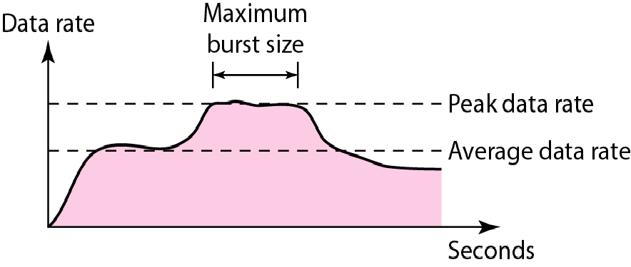
Figure 1 Traffic descriptors
3

Slide 4
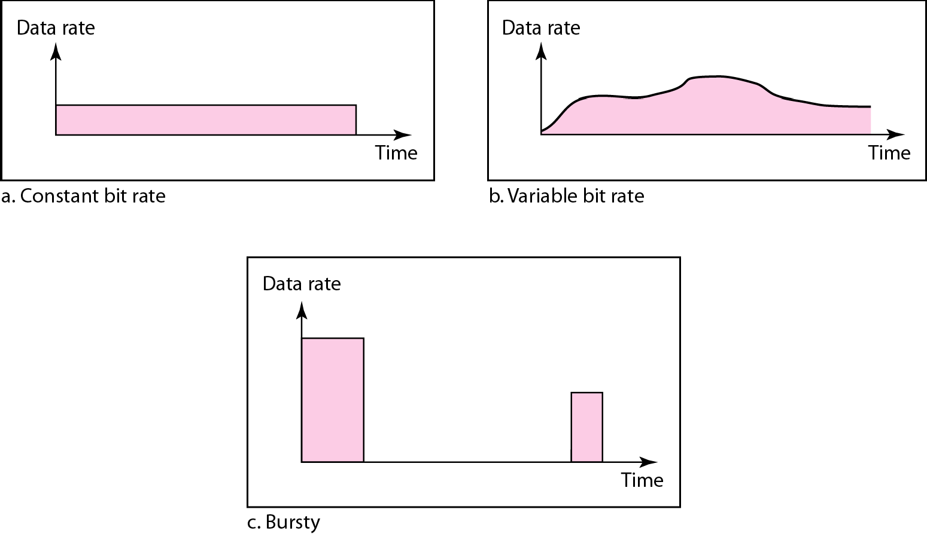
Figure 2 Three traffic profiles
4

Slide 5
2 CONGESTION
Congestion in a network may occur if the load on the network—the number of packets sent to the network— is greater than the capacity of the network—the number of packets a network can handle. Congestion control refers to the mechanisms and techniques to control the congestion and keep the load below the capacity..
Topics discussed in this section:
Network Performance
5

Slide 6
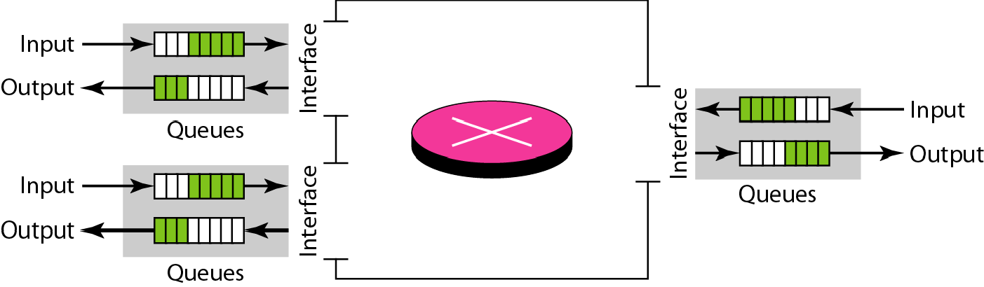
Figure 3 Queues in a router
6

Slide 7
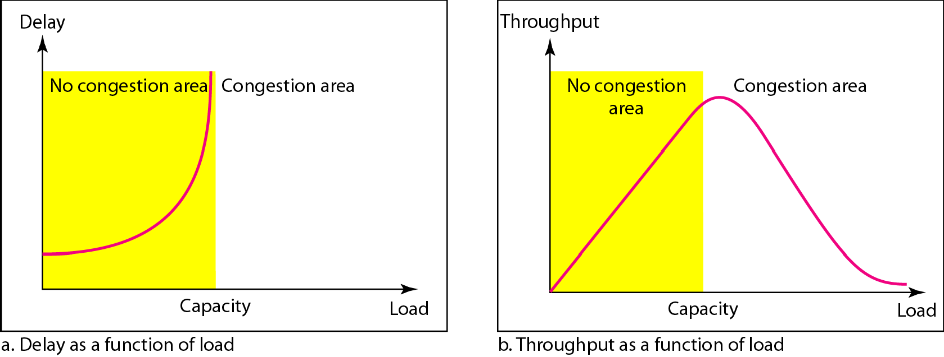
Figure Packet delay and throughput as functions of load
7

Slide 8
3 CONGESTION CONTROL
Congestion control refers to techniques and mechanisms that can either prevent congestion, before it happens, or remove congestion, after it has happened. In general, we can divide congestion control mechanisms into two broad categories: open- loop congestion control (prevention) and closed-loop congestion control (removal)....
Topics discussed in this section: Open-Loop Congestion Control Closed-Loop Congestion Control
8

Slide 9
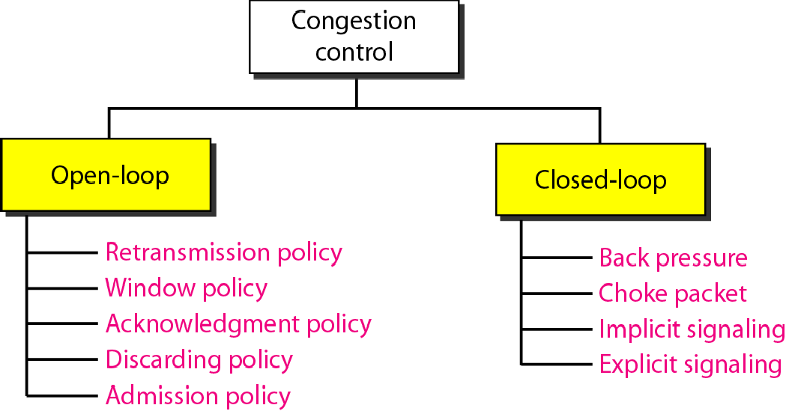
Figure 5 Congestion control categories
9

Slide 10
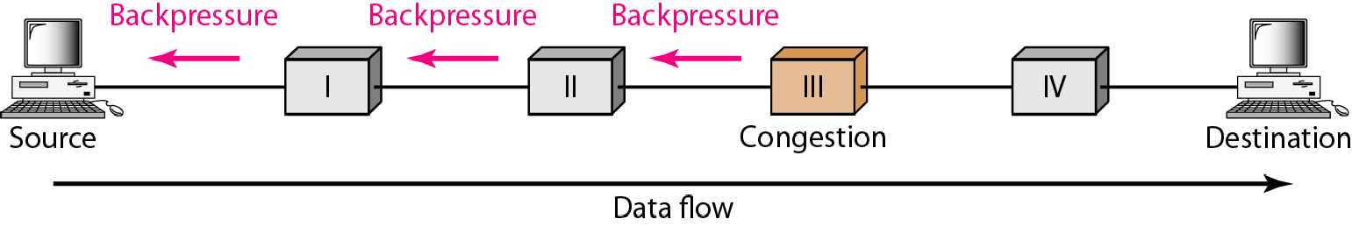
Figure 6 Backpressure method for alleviating congestion

Slide 11
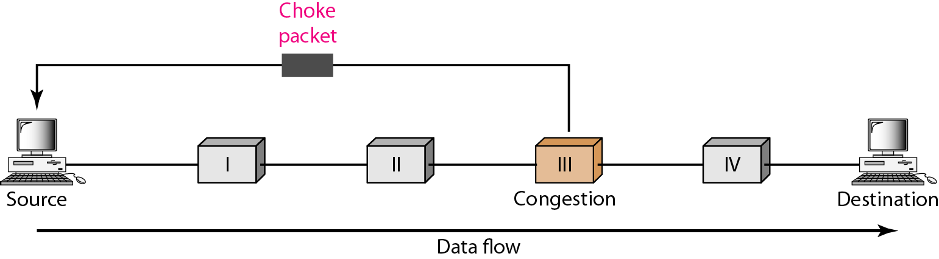
Figure 7 Choke packet

Slide 12
4 TWO EXAMPLES
To better understand the concept of congestion control, let us give two examples: one in TCP and the other in Frame Relay..
Topics discussed in this section: Congestion Control in TCP Congestion Control in Frame Relay

Slide 13
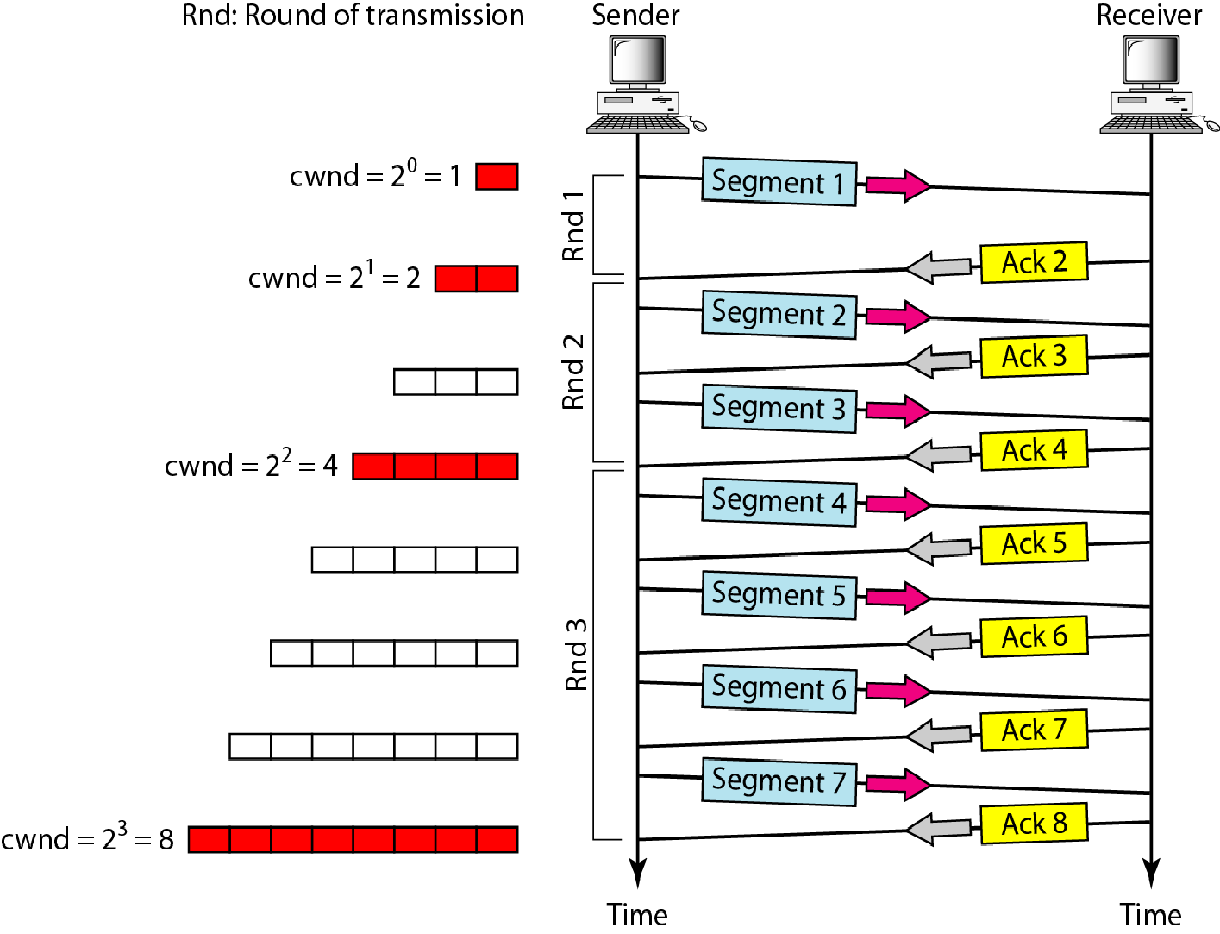
Figure 8 Slow start, exponential increase

Slide 14

Note
In the slow-start algorithm, the size of the congestion window increases exponentially until it reaches a threshold.

Slide 15
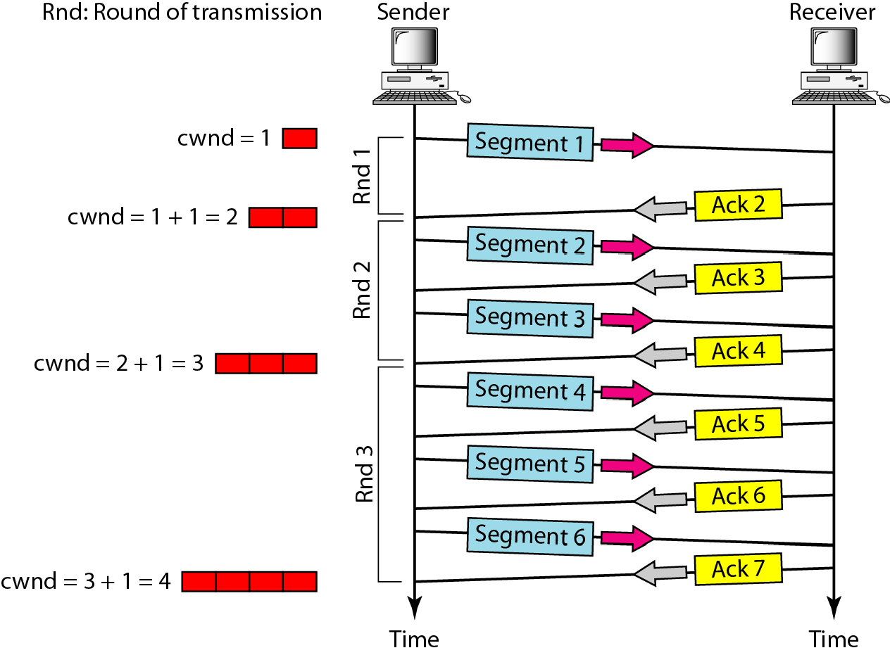
Figure 9 Congestion avoidance, additive increase

Slide 16
Note
In the congestion avoidance algorithm, the size of the congestion window increases additively until
congestion is detected.

Slide 17

Note
An implementation reacts to congestion detection in one of the following ways:
❏ If detection is by tim -out, a new slow start phase starts.
❏ If detection is by three ACKs, a new congestion avoidance phase starts.

Slide 18
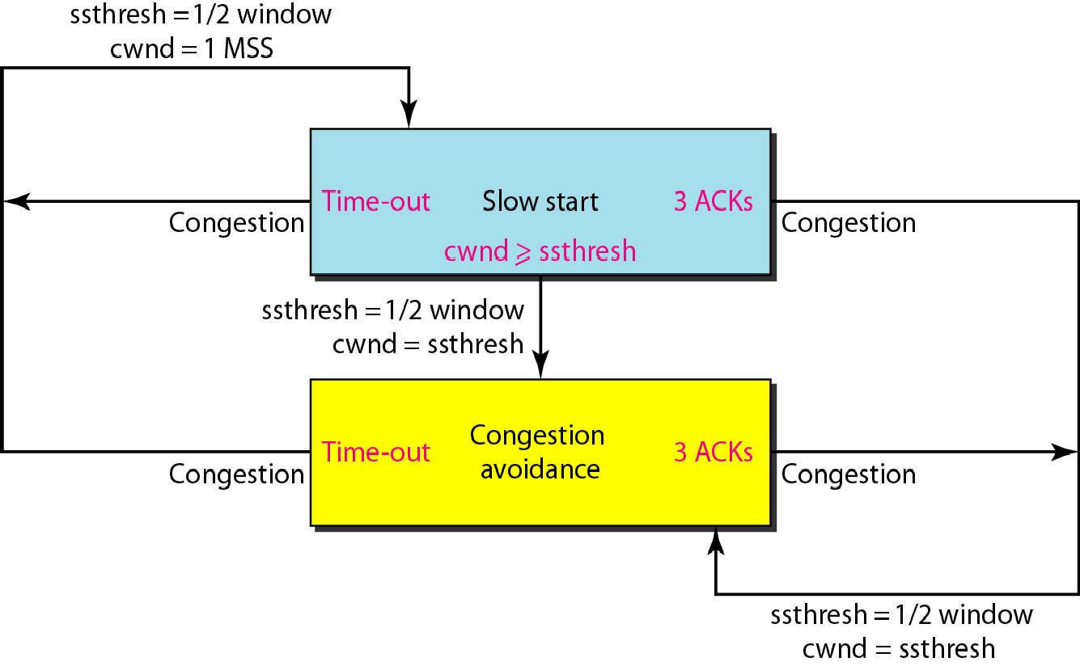
Figure 10 TCP congestion policy summary

Slide 19
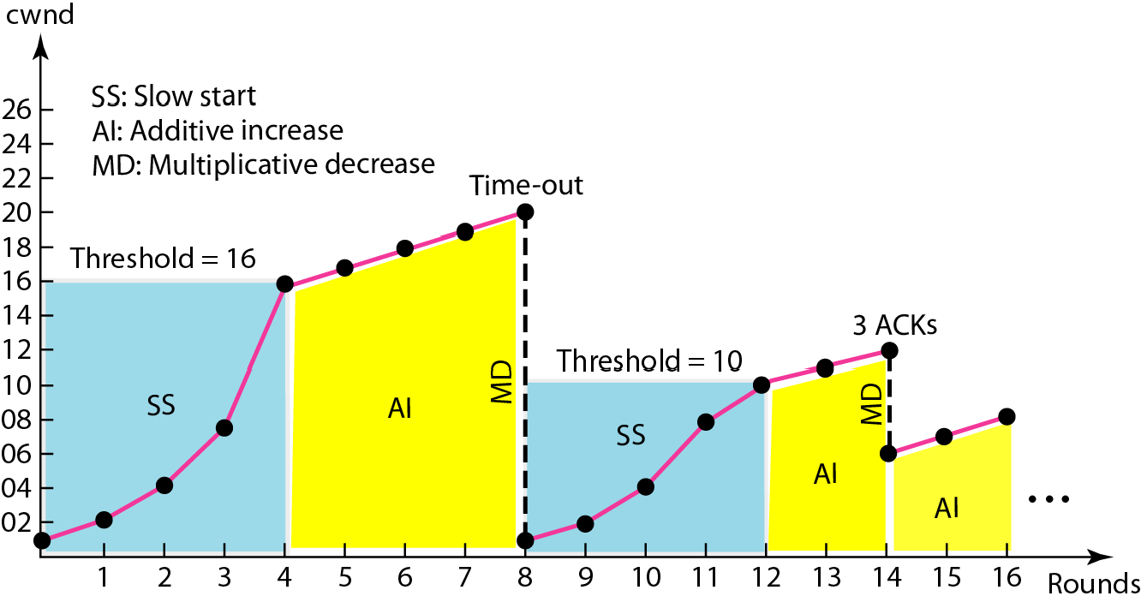
Figure 11 Congestion example

Slide 20
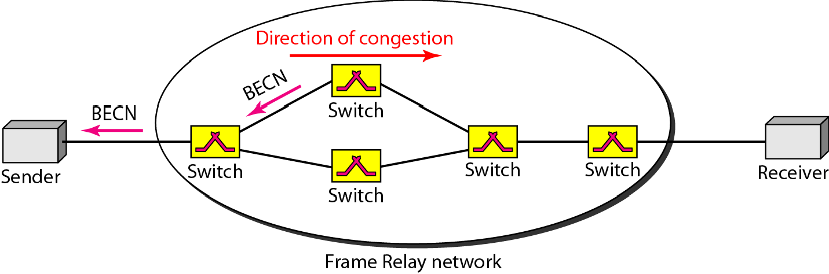
Figure 12 BECN

Slide 21
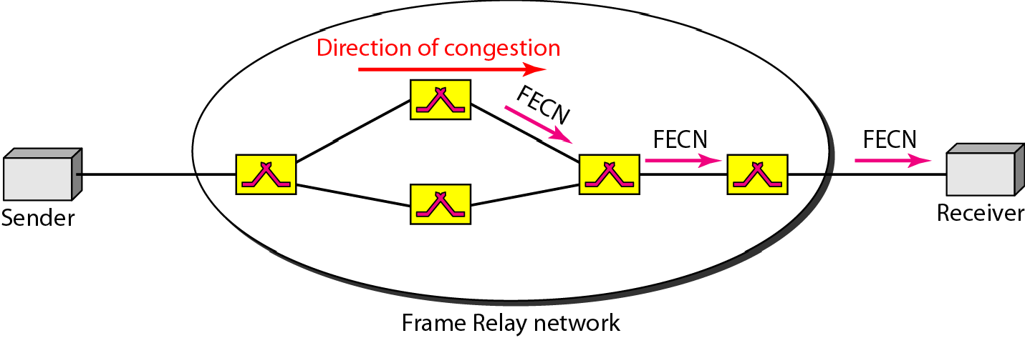
Figure 13 FECN

Slide 22
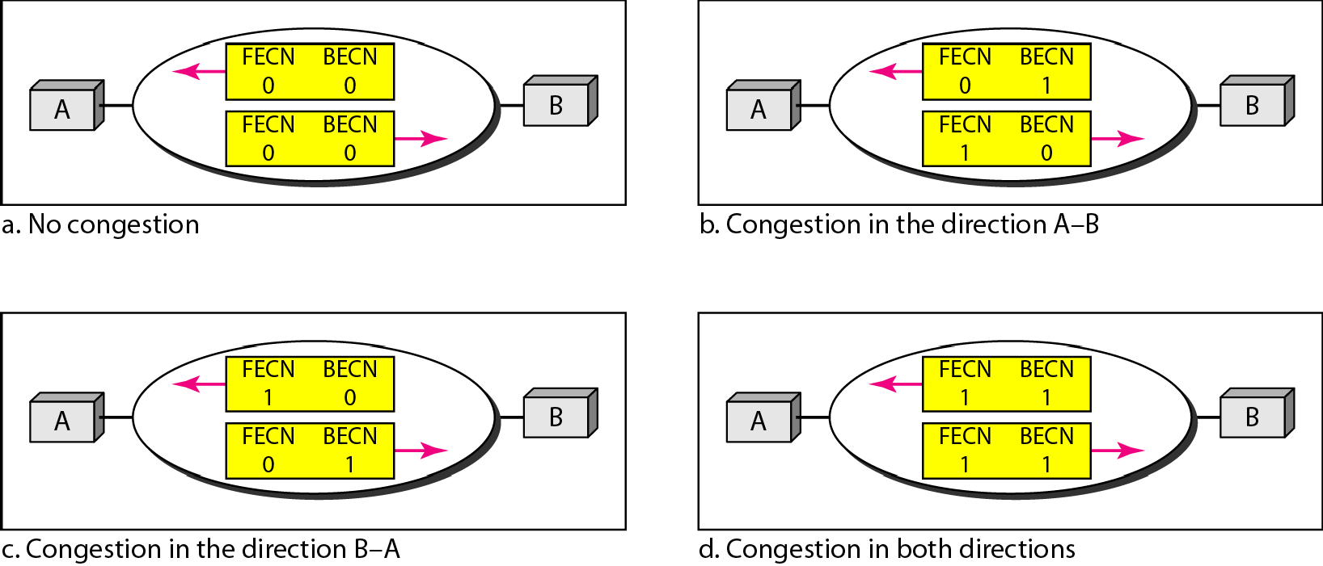
Figure 14 Four cases of congestion

Slide 23
5 QUALITY OF SERVICE
Quality of service (QoS) is an internetworking issue that has been discussed more than defined. We can informally define quality of service as something a flow seeks to attain.
Topics discussed in this section:
Flow Characteristics Flow Classes

Slide 24
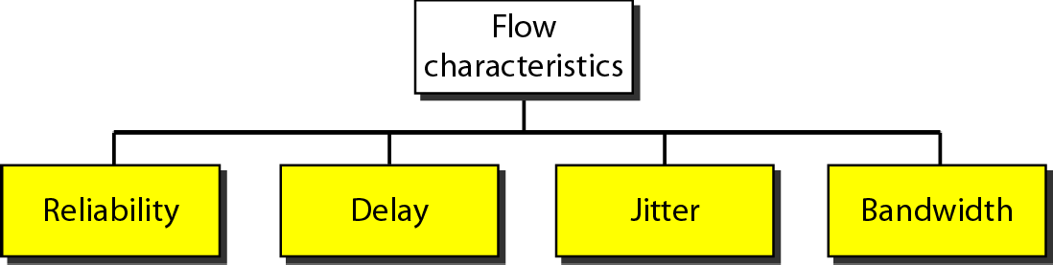
Figure 15 Flow characteristics
Reliability: Capacity of the network to offer the same services even during a failure.
Delay: is the time it takes for data to move from one endpoint on the network to another.
Jitter: is the difference in delay between two packets.
Bandwidth: is a measure of how much information a network, a group of two or more devices that communicate between themselves, can transfer

Slide 25
6 TECHNIQUES TO IMPROVE QoS
In Section 5 we tried to define QoS in terms of its characteristics. In this section, we discuss some techniques that can be used to improve the quality of service. We briefly discuss four common methods: scheduling, traffic shaping, admission control, and resource reservation.
Topics discussed in this section:
Scheduling Traffic Shaping
Resource Reservation Admission Control

Slide 26
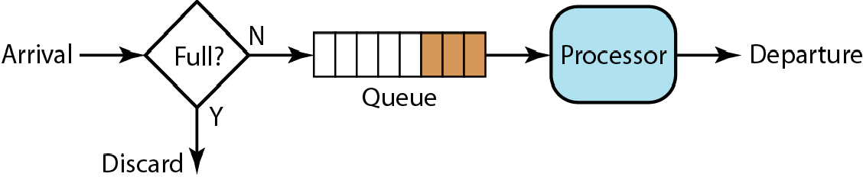
Figure 16 FIFO queue

Slide 27
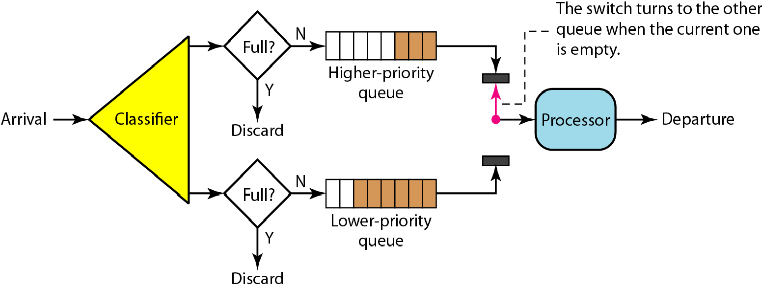
Figure 17 Priority queuing

Slide 28
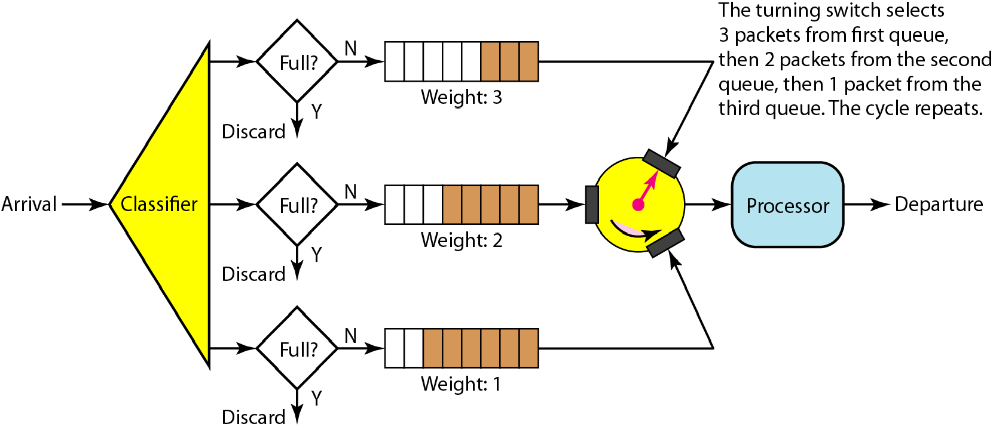
Figure 18 Weighted fair queuing

Slide 29
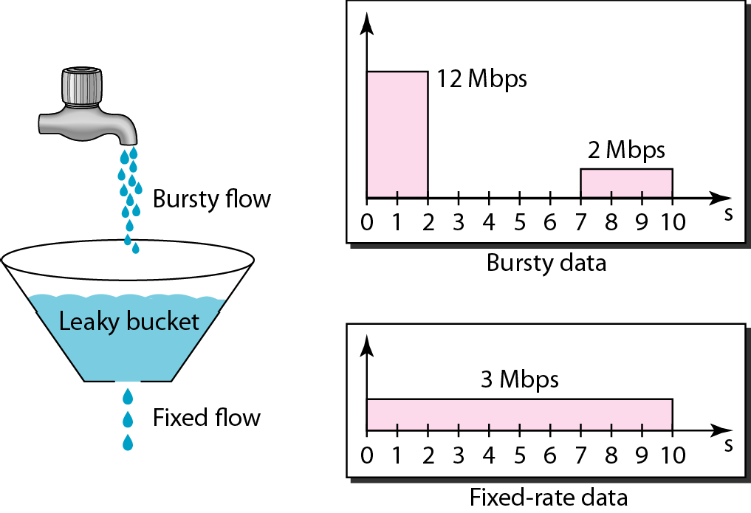
Figure 19 Leaky bucket

Slide 30
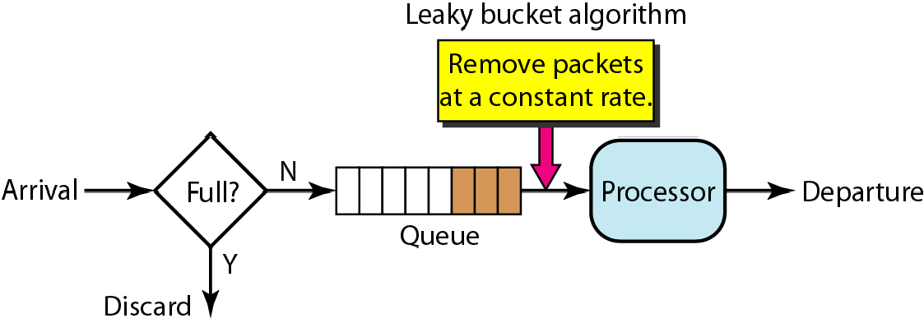
Figure 20 Leaky bucket implementation

Slide 31

Note
A leaky bucket algorithm shapes bursty traffic into fixed-rate traffic by averaging the data rate. It may drop the packets if the bucket is full.

Slide 32

Note
The token bucket allows bursty traffic at a regulated maximum rate.

Slide 33
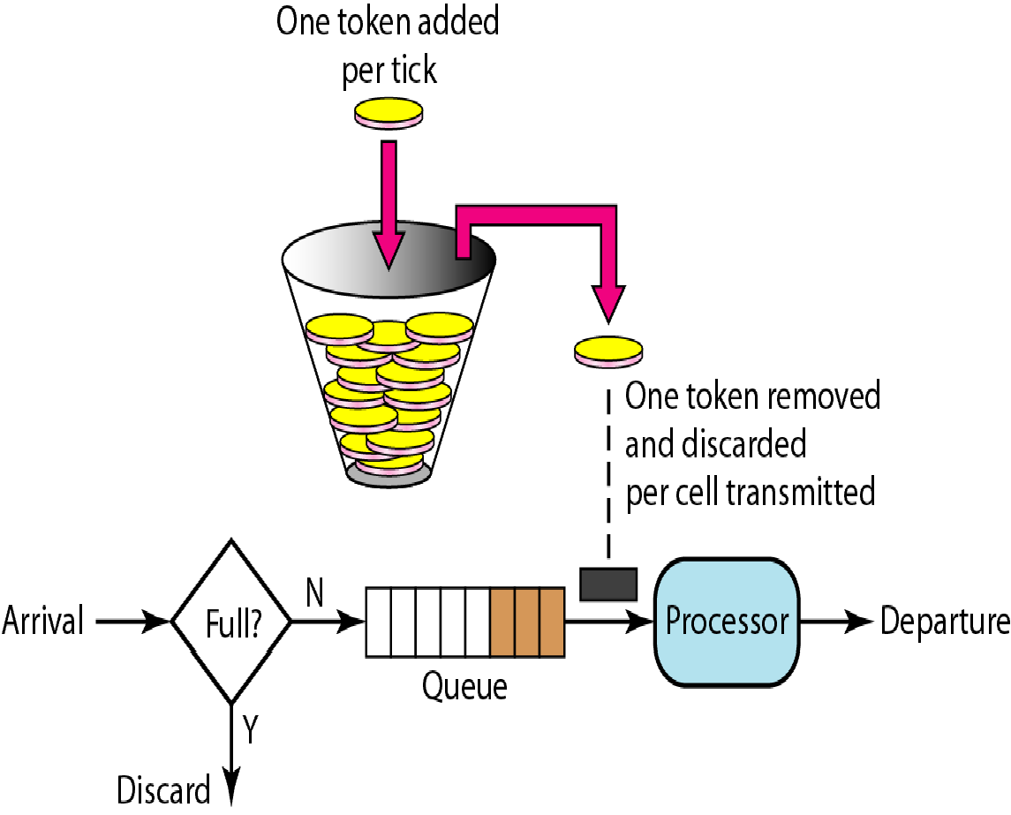
Figure 21 Token bucket

Slide 34
7 INTEGRATED SERVICES
Two models have been designed to provide quality of service in the Internet: Integrated Services and Differentiated Services.. We discuss the first model here.
Topics discussed in this section:
Signaling
Flow Specification Admission Service Classes RSVP
Problems with Integrated Services

Slide 35
Note
Integrated Services is a flow-based QoS model designed for IP.

Slide 36
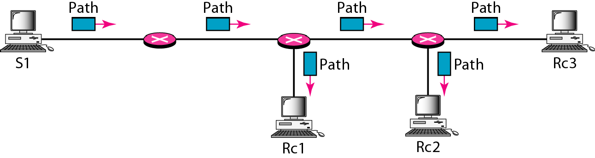
Figure 22 Path messages

Slide 37
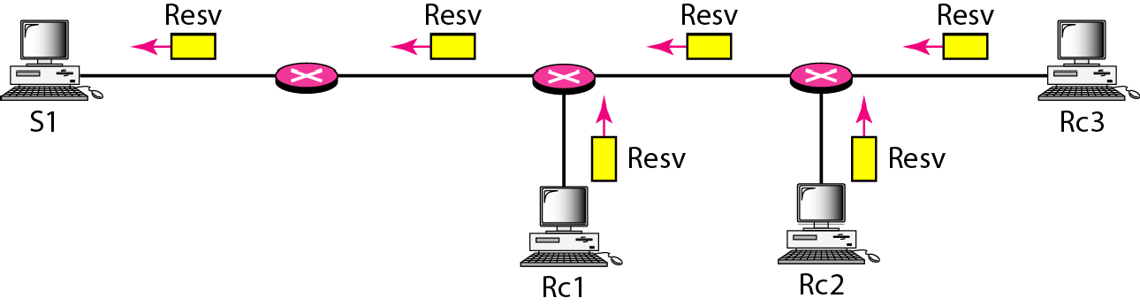
Figure 23 Resv messages

Slide 38
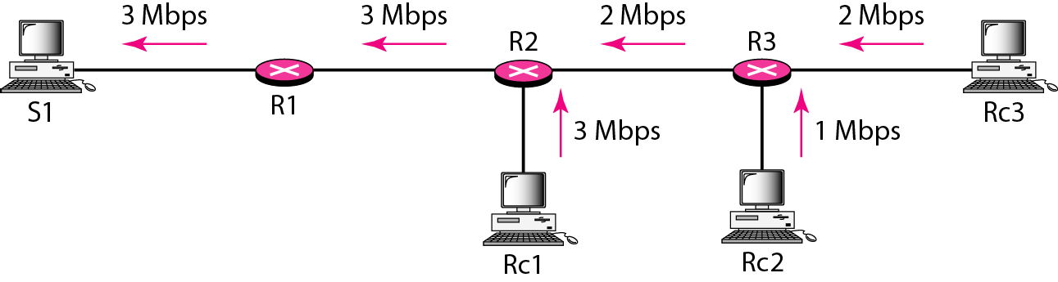
Figure 24 Reservation merging

Slide 39
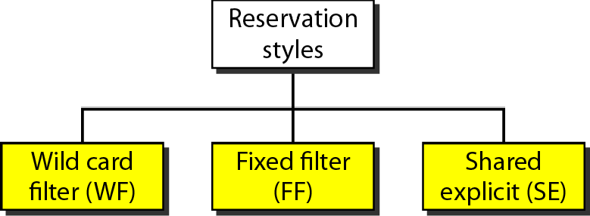
Figure 25 Reservation styles

